Slide 1

craft brewery eda Rob Pollock YouTube

Slide 2
Background Information
2 data sets regarding craft breweries and beers in the United States
2,410 Beers
558 Breweries
Data includes information on:
The name and location of the Brewery (City and State)
The name, alcohol content, style, and bitterness of the beers in the dataset
Alcohol content is measured in ABV and will be referred to as ABV
Bitterness is measured in IBU and will be referred to as IBU

Slide 3
Issues with Missing Data
Summary of missing data:
Brewery Data Set: No missing data noted (no “NA’s”)
Beer Data Set: 62 (2.5%) ABV Values &1005 (42%) IBU Values Missing
The beer and brewery data sets were joined using a left join on the Brewery_id in the beer file and the Brew_ID column in the breweries file. No missing values were created as a result of this join and this allowed us to match each beer to the brewery that produced it.
The missing ABV and IBU values were present in the beer data file from the beginning.
The missing values were replaced with the mean ABV and IBU for each beer style.
After this replacement process there were no missing values for ABV and only 52 (2.16%) missing values for IBU.
The missing IBU values were either in very small amounts, 1 or 2 beers, or belonged to very sweet styles of beer such as ciders. We felt comfortable omitting these beers from our analysis.
While there did not appear to be outliers skewing the mean, the mean must be used with caution. Extreme values can pull the mean in one direction or the other.

Slide 4
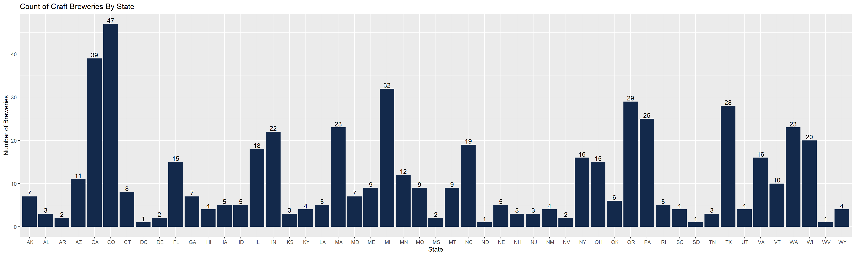
Number of Craft Breweries By State
We plotted how many breweries were present in each state out of the 558 total breweries we had data for:

Slide 5
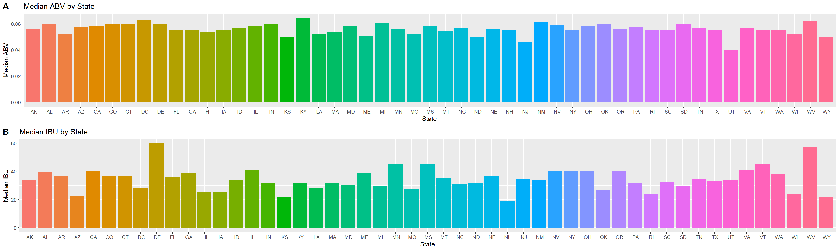
Median ABV and IBU by State
The following charts show the median (middle) ABV and IBU across all beer styles for each state

Slide 6
Maximum abv and ibu
Looking across all beer styles we found the following beers that represented the maximum ABV and maximum IBU value
The beer with the maximum ABV at 12.8%:
Lee Hill Series Vol. 5 – Belgian Style Quadrupel Ale
Quadrupel (Quad)
Upslope Brewing Company Boulder, CO
The beer with the maximum IBV at 138:
Bitter Bitch Imperial IPA
American Double / Imperial IPA
Astoria Brewing Company Astoria,OR

Slide 7
Summary Statics FOR ABV
We next explored some summary statistics for ABV across all beer styles:
The minimum ABV found was 0.1%
The maximum ABV found was 12.8%
The median ABV was 5.6%
The mean ABV was 5.98%
Most beers fall between 5% and 6.7% ABV
Min | 1st Qu. | Median | Mean | 3rd Qu. | Max | NA # | Std Dev
0.0010 | 0.05 | 0.056 | 0.05977 | 0.67 | .128 | 62 | 0.0135

Slide 8
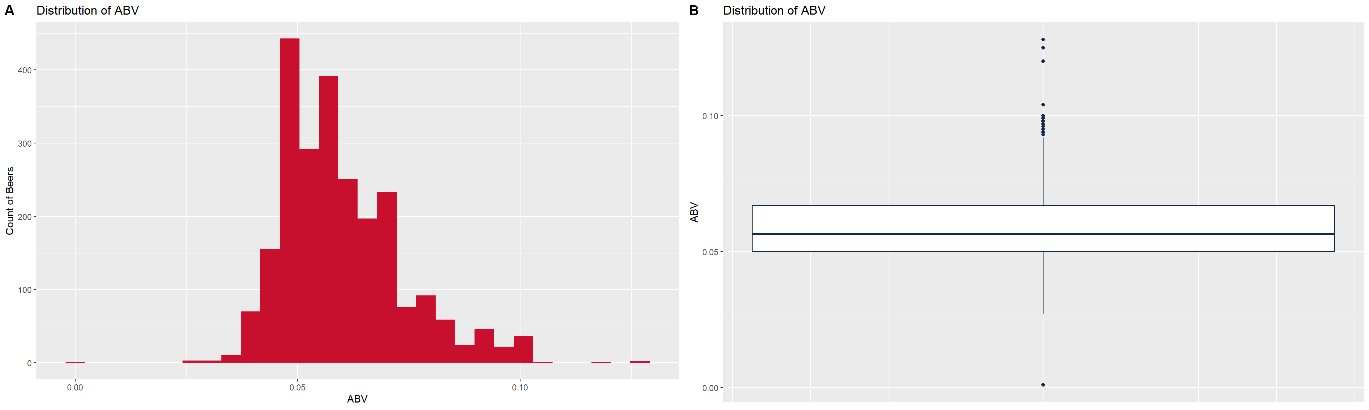
distribution of Abv across all beers
These plots show the distribution of ABV for all beer styles. Again, we see the majority of beers falling between 5% – 6.7% ABV
The boxplot shows us where our median ABV falls as well as showing other useful information such as outliers

Slide 9
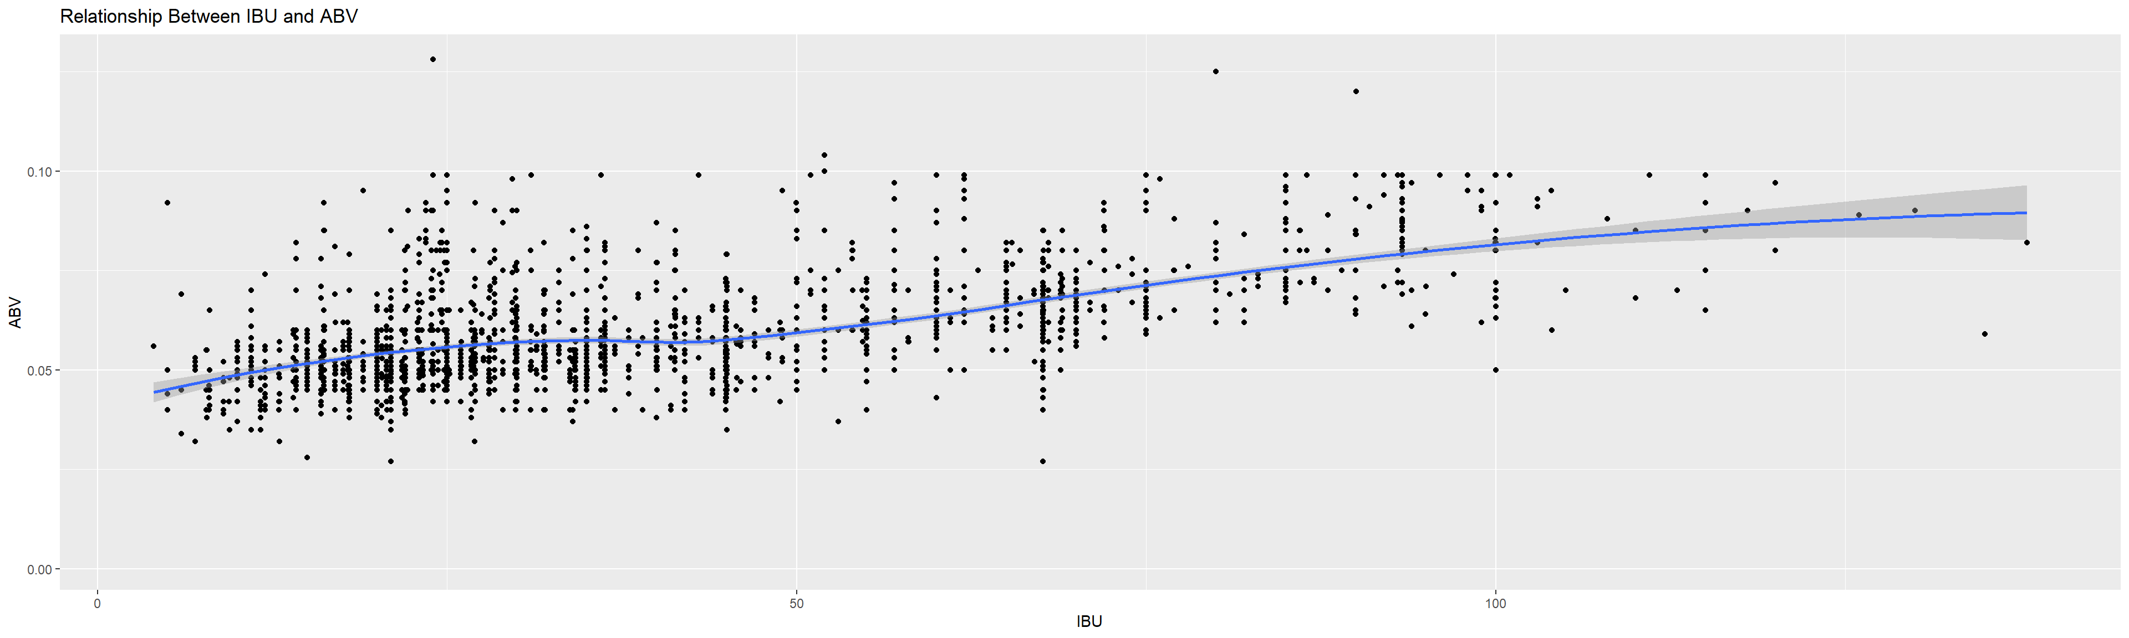
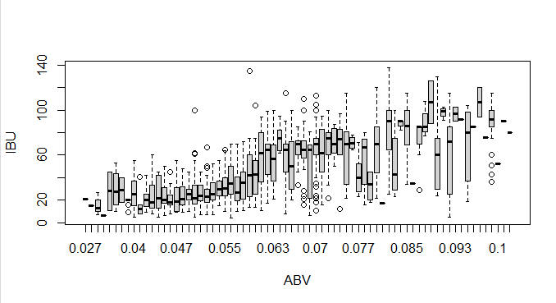
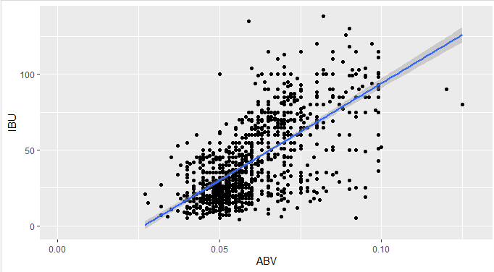
relationship between abv and ibu
Scatter plot with missing data replacement: Little to no correlation between IBU and ABV:
For beers between roughly 0 and 25 IBU we see a gradual increase in the ABV
At 25 to 50 IBU the trend stays relatively consistent with ABV close to 5%
There is a stronger linear trend between 50 and 100 IBU with ABV increasing consistently
Over 100 IBU the relationship is fairly flat again
Replacement with means of large data amounts can skew data: thus, data without replacement also shown – weak correlation
Scatter plot: Replacement of
missing data with mean of similar beer styles
Scatter plot: Without replacement
of missing data
r = 0.67 (weak correlation)
IBU and ABV: t = 33.863, df = 1403, p-value < 2.2e-16
alternative hypothesis: true correlation is not equal to 0
95 percent confidence interval:
0.6407982 0.6984238
sample estimates: cor 0.6706215

Slide 10
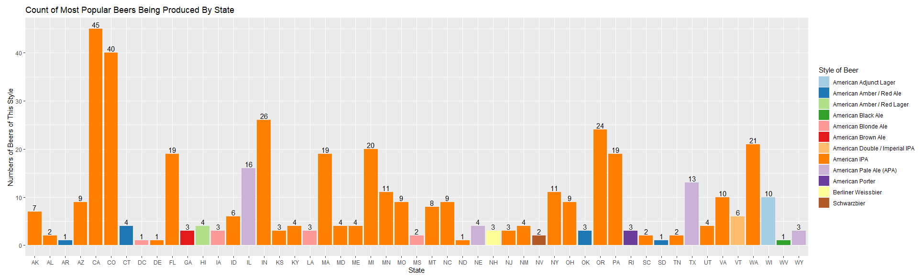
Additional insights
We were also asked to look at an additional insight that the data might provide
We choose to plot the top beer produced for each state and how many of that style of beer were in our data set
This information can be used to determine whether Budweiser wants to compete in a crowded segment for any given market or if they may want to look for alternative options

Slide 11
Additional Insight
IBU (International Bitterness Units):
Is a scale used to quantify the bitterness perception of beer.
IBUs are a chemical measurement of the number of bittering / bitter producing chemicals (namely isomerized and oxidized alpha and beta acids, polyphenols). Scale based on chemical analysis – spectrophotometry – not sensory perception.
Drinkable beers are considered to have a scale between 5 and 120 IBUs. Most beers fall between 15-80. (technically the scale can go to infinity).
The alpha and beta oxidized acids are produced namely from the hops used in manufacturing.
There are no state regulations on the amount of IBU’s found in beer.
ABV(Alcohol By Volume):
Beer contains a narrow range of alcohol usually between 4 and 7% by volume with the average being 5%.
Beers typically fall between 3 and 13% where most commercial beers range between 4-7%. Craft beers can be as high as 20%.
Beer alcohol content is regulated by states. The allowable content range varies from state to state.
It is felt alcohol does not directly cause the sensation of bitterness but helps to bind the bittering alpha and beta oxidized acids (found mainly in hops) to “bitter receptors” on the tongue.
It is also felt the perception of bitterness has a genetic based component.
For the most part, the ABV values are clustered where the IBU are scattered. The data does show same ABV values corresponding to varying levels of IBU values, some being extremely high. Thus there appears to be little or weak correlation between ABV and IBU. IBU likely correlates with other factors present.

Slide 12
In summary
Given 2 data sets with 2,410 beers and 558 breweries
Data was joined this data together using the Brewery_ID field and replaced the missing ABV and IBU values with the mean for each style of beer
Plotted how many breweries exist in each state
Showed the median ABV and IBU values across all beers for each state
Colorado makes the strongest ABV beer at 12.8% and Oregon produces the highest IBU beer at 138.
Provided statistics about the ABV value and how it is distributed across all beers. Most beers fall in the 5% to 6.7% ABV range.
Showed a lack of a or a weak correlation, at best, between IBU and ABV. The relationship is stronger for beers between 0 and 25 IBU and 50 to 100 IB.
Demonstrated scientifically reasons why there is little to no correlation between IBU and IBV values
Provided a graphic showing the most popular beer style for each state and how many of those beer styles are being produced in each state

Slide 13
Youtube link
https://youtu.be/cfpedy8zDYI

Slide 14
Thank you for your time Rob Pollock You Tube Version

